Slide 1
Employee Data Analysis using Excel
STUDENT NAME: ATHISHWAR K
REGISTER NO: 2213211042005
DEPARTMENT: B.COM ( CORPORATE SECRETARYSHIP)
COLLEGE : PRESIDENCY COLLEGE

Slide 2
EMPLOYEE PERFORMANCE ANALYSIS USING EXCEL THROUGH THEIR PERFORMANCE
Employee Performance Analysis using Excel

Slide 3


AGENDA
Problem Statement
Project Overview
End Users
Our Solution and Proposition
Dataset Description
Modelling Approach
Results and Discussion
Conclusion
3/21/2024 Annual Review

Slide 4
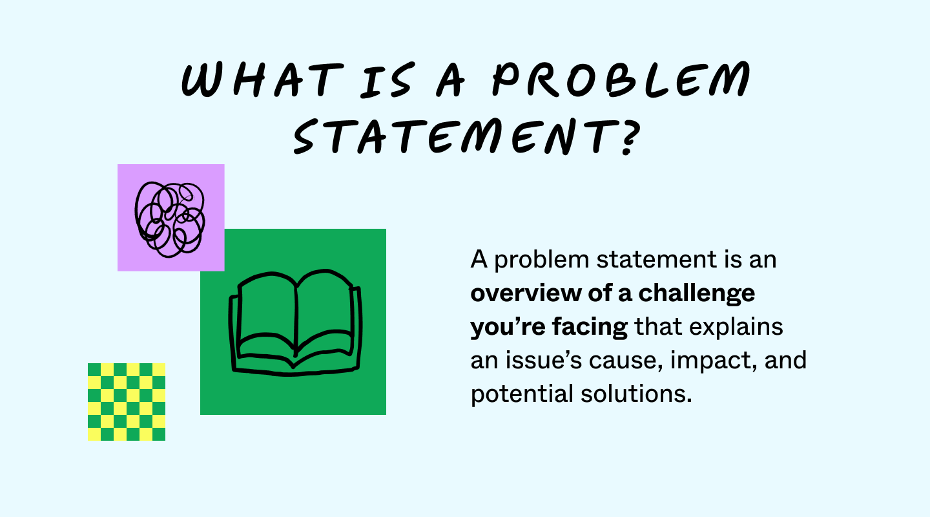

PROBLEM STATEMENT
Problem statements summarize a challenge you want to resolve, its causes, who it impacts, and why that’s important. They often read like a concise overview managers can share with stakeholders and their teams.

Slide 5

PROJECT OVERVIEW
A project overview is a detailed description of a project's goals and objectives, the steps to achieve these goals, and the expected outcomes. In addition, a project overview enables you to outline the project schedule, budget, necessary resources, and status.

Slide 6

WHO ARE THE END USERS?
An end user is a person or other entity that consumes or makes use of the goods or services produced by businesses.
In this way, an end user may differ from a customer since the entity or person that buys a product or service may not be the one who actually uses it.
Delivery to the end user is often the final step in manufacturing and selling products.
End user experience and support are crucial for the success of user-oriented products and services.

Slide 7

OUR SOLUTION AND ITS VALUE PROPOSITION
A value proposition is a short statement that communicates why buyers should choose your products or services. It's more than just a product or service description — it's the specific solution that your business provides and the promise of value that a customer can expect you to deliver.

Slide 8
Dataset Description
A data set (or dataset) is a collection of data. In the case of tabular data, a data set corresponds to one or more database tables, where every column of a table represents a particular variable, and each row corresponds to a given record of the data set in question.

Slide 9

THE "WOW" IN OUR SOLUTION
WOW stands for “Wonderful Original Work of Art.” Invented in a Teaching for Artistic Behavior classroom by Barbara Berry, a TAB educator in Brunwick, ME, the WOW cycle is a way to motivate students to create long-term projects
3/21/2024 Annual Review
9

Slide 10
MODELLING
Modeling is the process of connecting data systems together, e.g., connecting a point-of-sale device to a CRM, or a sales database to a stock system.
Data modeling is a process of creating a conceptual representation of data objects and their relationships to one another
Data modeling is the process of creating a simplified visual diagram of a software system and the data elements it contains
10

Slide 11
RESULTS
EMPLOYEE COUNT IN CHART
JAN
FEB
MARC
APR
MAY
JUN
JUL
AUG
SEP
11

Slide 12
conclusion
THANKS FOR GIVING THE GREAT OPPORTUNITTY IN PART OF THE PROJECT

